Slide 1
Battle of the neighbourhoods
Choosing where to live in Singapore
IBM Capstone Project – Mike Mander

Slide 2


Scenario
A family with 2 young children are moving to Singapore
One parent has been given a job at IBM as a Data Scientist
They are new to the area and have no idea where the best place to live that would suit their circumstances.
Can we use data analysis to help them choose?

Slide 3


Data
Data will be collected from Foursquare and the Singapore Data website to aid in the analysis.

Slide 4
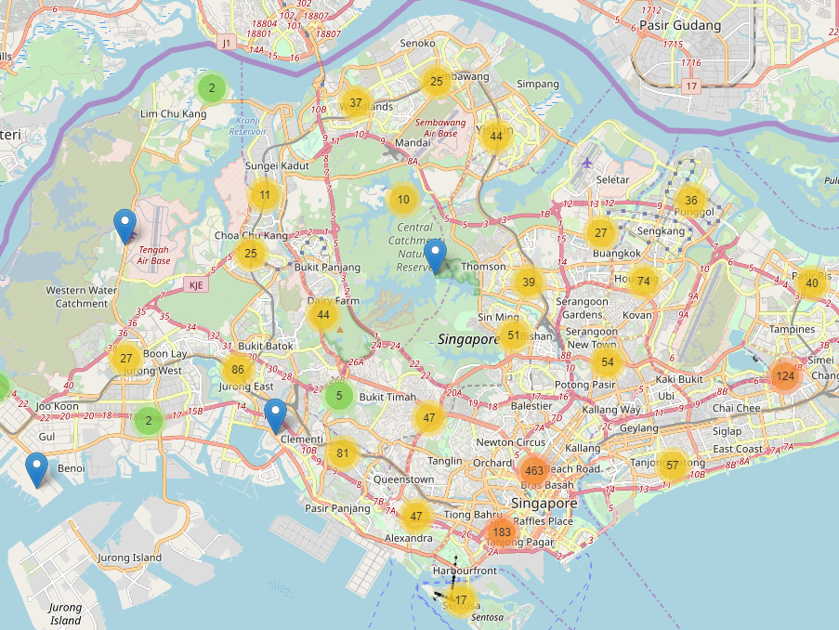
Locations of venues
Cafe’s
Gardens
Play Areas
Parks
Libraries
Doctors
Nursery Schools
Baby Stores
Museums

Slide 5
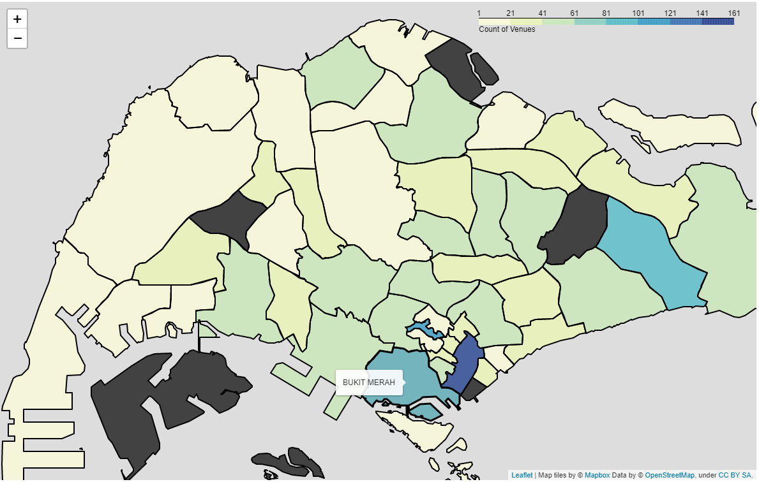
Distribution of venues
This shows the areas of Singapore with the highest number of searched venues that are relevant to parents with children.
Yellow = Low
Green = Mid
Blue = High

Slide 6
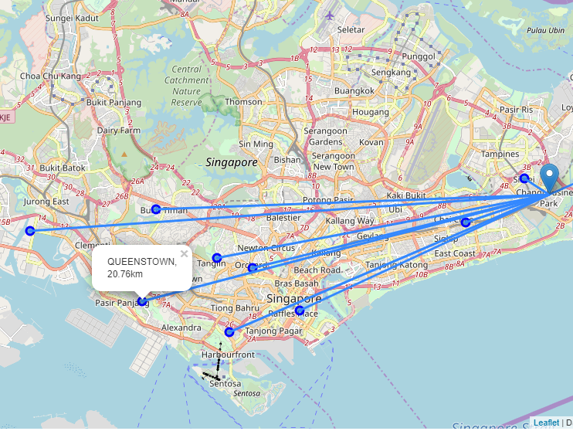
Proximity to IBM Office
Distances from centre of area to IBM office in km.
Tampines – 1.45
Changi – 3.96
Bedok – 4.31
Downtown Core – 13.59
Orchard – 15.07
Tanglin – 16.70
Bukit Merah – 19.41
Queenstown – 20.76
Jurong East – 25.67

Slide 7
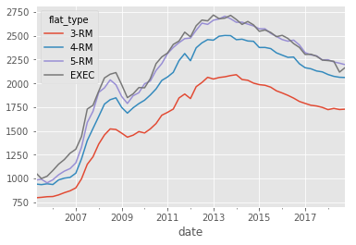
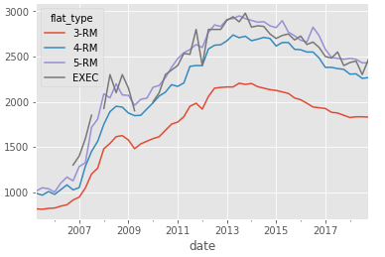
Median Flat Rental prices (in $SGD per month)
Singapore
Shortlisted areas

Slide 8
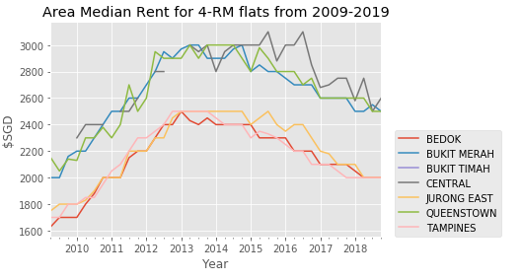
Median rent for 4-rm flats in Shortlist
The Central, Bukit Merah and Queenstown prices are over $500 per month more expensive than Tampines, Bedok and Jurong East.
The closer you get to the business district in Downtown the more expensive the flats become.

Slide 9
Results
Best option from the data analysis is Tampines
A close second is Bedok
Both areas are similarly priced for a large flat, well connected with transport links and contain large numbers of venues with relevance to young children
Also crucially are close to the IBM office for a reduced commuting time.

Slide 10
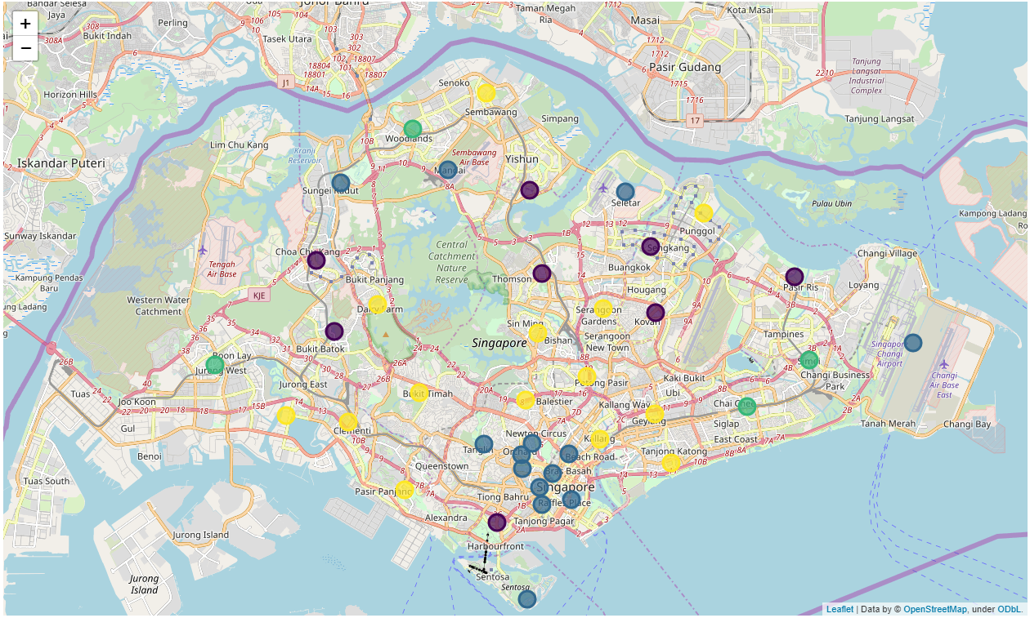
Population clustering
There are 2 other areas similar to Bedok and Tampines, based on ethnic populations
Woodlands in the north and Jurong West.
They might also be options to consider if commuting becomes less of an influence.

